Slide 1
LIF model for decision making in the LIP area

Slide 2
Decision Making Process
Gather evidences from the outside
Elaborate and store those evidences in the working memory
Perform task based on the working memory

Slide 3
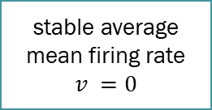
Brain activity
Many studies: work of Newsome et al., 1989; Salzman, 1990; Britten et al. 1996; Shalden et al., 1996
Middle Temporal area send stimuli to the Lateral Intraparietal Cortex (LIP) area
Persistent activity in subgroups of LIP
LIP
1
Leaky integrate and Fire (LIF) model to schematize the process
MT
neural persistent activity
in one of the selective
subgroup in the LIP area
stable average mean firing rate
$$v =0$$
2
3

Slide 4

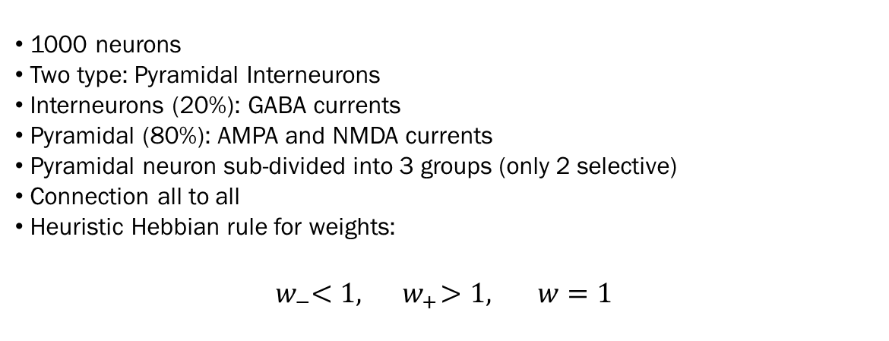








LIP model
1000 neurons
Two type: Pyramidal Interneurons
Interneurons (20%): GABA currents
Pyramidal (80%): AMPA and NMDA currents
Pyramidal neuron sub-divided into 3 groups (only 2 selective)
Connection all to all
Heuristic Hebbian rule for weights: ${ w}_{−}<1, { w}_{+}>1, w=1$
LIP
$$w_$$
$$w$$
2
$$w_{+}$$
External stimuli
1
Interneurons
$$w_{+}$$
$$w_$$
$$w$$
3
$w$_
$$w_{+}$$
$$w$$

Slide 5
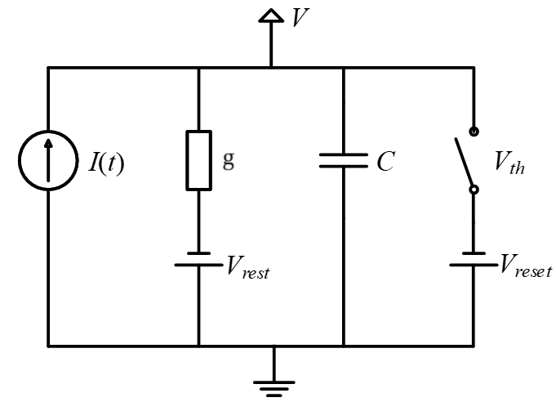

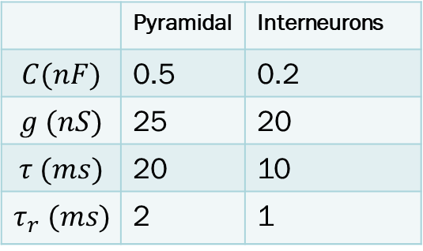
Neuron LIF model
We are interested in the firing rate not the action potential shape
Voltage reset and Voltage threshold to simulate spikes
Refractory time for subsequent spikes
Biophysical model for synaptic current
Gen eq:$C\frac{dV}{dt}=−g\left(V\left(t\right)−V_{rest}\right)−I_{syn}(t)$
 | Pyramidal | Interneurons
$$C(nF)$$ | 0.5 | 0.2
$$g (nS)$$ | 25 | 20
$$τ (ms)$$ | 20 | 10
$$τ_{r} (ms)$$ | 2 | 1

Slide 6

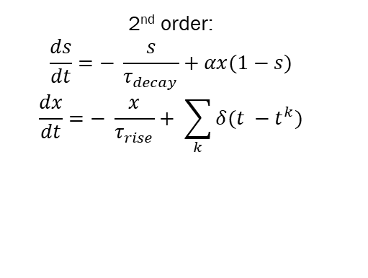
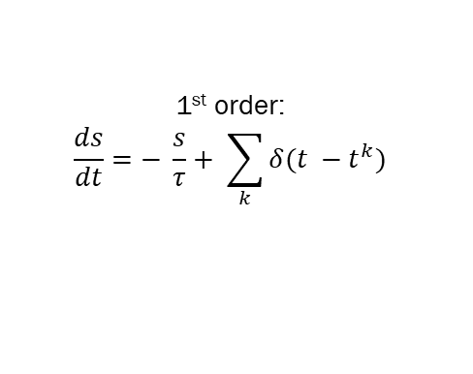
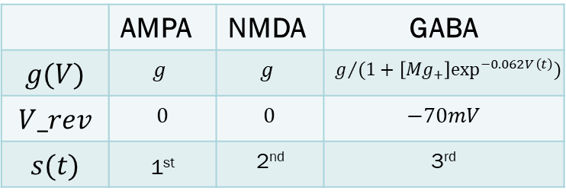
Synaptic currents
Voltage dependent
Depend on conductances
The regime it’s working on depends on the reversal potential
Proportional to open channel
Open channels respect stochastic kinetic schemes
External currents
$$I_{syn}=wg\left(V\right)s\left(t\right)\left(V\left(t\right)−V_{rev}\right)$$
GABA
AMPA and NMDA
 | AMPA | NMDA | GABA
$$g(V)$$ | $$g$$ | $$g$$ | $$g/{(1+\left[Mg_{+}\right]\exp^{−0.062V\left(t\right)})}$$
$$V_rev$$ | $$0$$ | $$0$$ | $$−70mV$$
$$s(t)$$ | 1st | 2nd | 3rd
1st order:
$$\frac{ds}{dt}=− \frac{s}{τ}+ \sum_{k}{δ(t −t^{k})}$$
2nd order:
$$\frac{ds}{dt}=− \frac{s}{τ_{decay}}+αx(1−s)$$
$$\frac{dx}{dt}=− \frac{x}{τ_{rise}}+ \sum_{k}{δ(t −t^{k})}$$

Slide 7


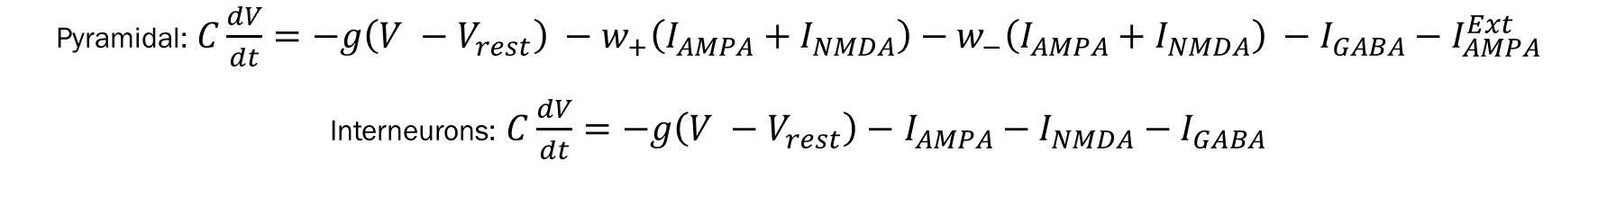

Final model
LIP
$$w$$
External stimuli
$$w_$$
2
Interneurons
$$w_{+}$$
1
$$w_{+}$$
$$w$$
$$w_$$
3
$w$_
$$w_{+}$$
$$w$$
Differential stochastic equation:
Pyramidal: $C\frac{dV}{dt}=−g\left(V −V_{rest}\right) −w_{+}\left(I_{AMPA}+I_{NMDA}\right)−w_{−}\left(I_{AMPA}+I_{NMDA}\right) −I_{GABA}−I_{AMPA}^{Ext}$
Interneurons: $C\frac{dV}{dt}=−g\left(V −V_{rest}\right)−$ $I_{AMPA}−I_{NMDA}−I_{GABA}$

Slide 8
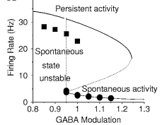
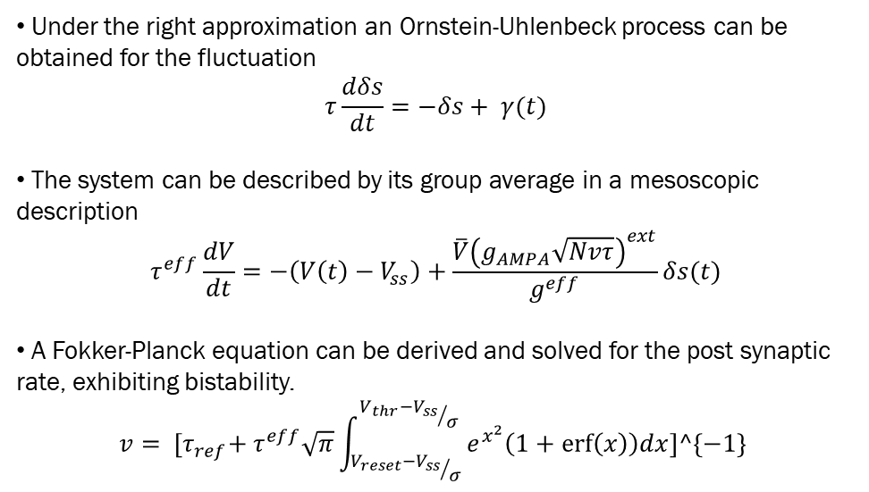
Bi - stability of the system
Approximations
neuron as RC circuit
Heuristic Hebbian rule for weights
Noise voltage independent
Linear dependence between current and presynaptic voltage
Fluctuation only due to external inputs
Diffusion approximation
Under the right approximation an Ornstein-Uhlenbeck process can be obtained for the fluctuation $τ\frac{dδs}{dt}=−δs+ γ(t)$
The system can be described by its group average in a mesoscopic description $τ^{eff}\frac{dV}{dt}=−\left(V\left(t\right)−V_{ss}\right)+\frac{\overline{V}{\left(g_{AMPA}\sqrt{Nvτ}\right)}^{ext}}{g^{eff}}δs(t)$
A Fokker-Planck equation can be derived and solved for the post synaptic rate, exhibiting bistability.
$$v= {[τ}_{ref}+ τ^{eff}\sqrt{π}\int_{{V_{reset}−V_{ss}}/σ}^{{V_{thr}−V_{ss}}/σ}{e^{x^{2}}\left(1+\operatorname{erf}\left(x\right)\right)dx}]^\{−1\}$$
Image from Brunet et, 2001

Slide 9
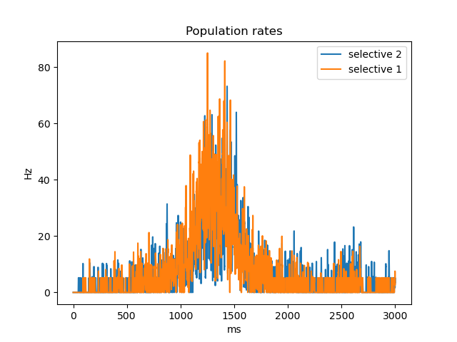
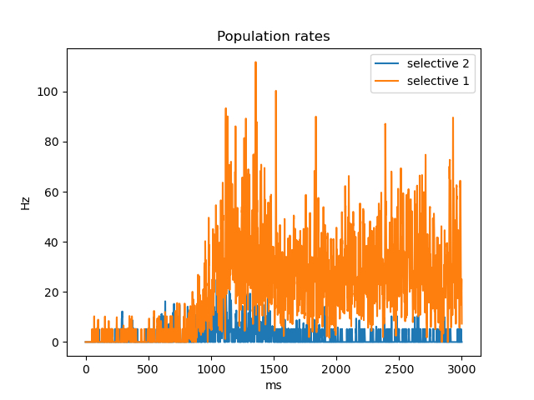
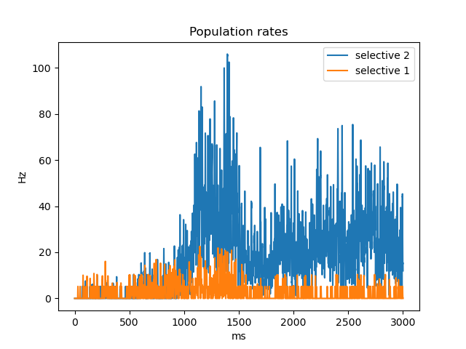
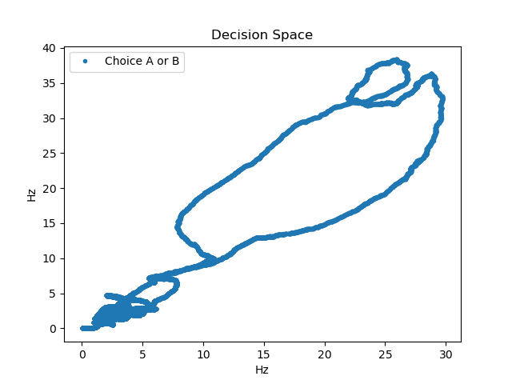
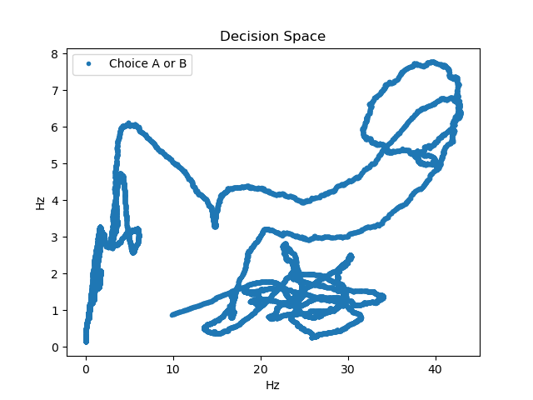
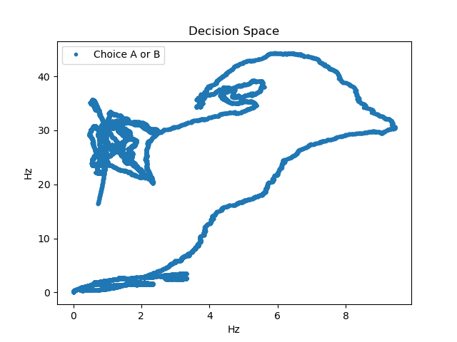
Simulation: Brian2
Equal stimuli for fixed time

Slide 10
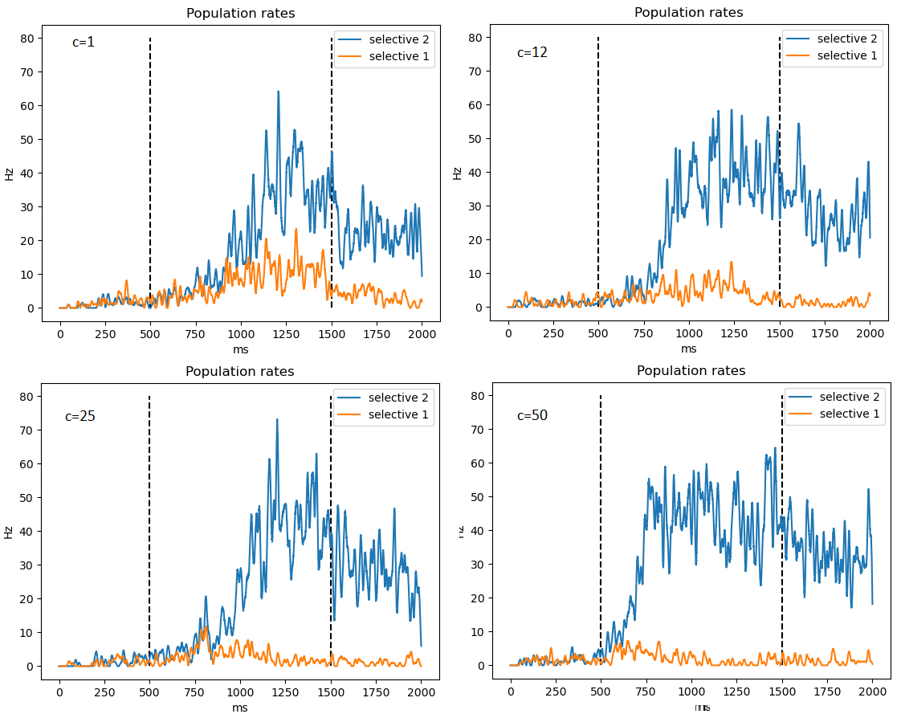
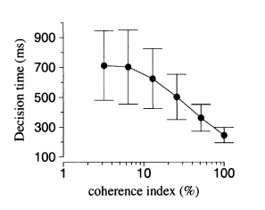
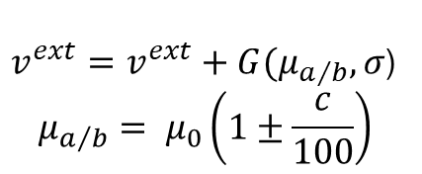
Simulation: Brian2
Different stimuli parameterized by “c”
$v^{ext}=v^{ext}+G(μ_{a/b}, σ$)
$$μ_{a/b}= μ_{0}\left(1±\frac{c}{100}\right)$$
Image from Brunet et, 2002

Slide 11
What can be done next?
Study how conductaces and weights affect firing rate, time response...
Find a probability for weights configuration which better represent experimental data
How to do it?

Slide 12
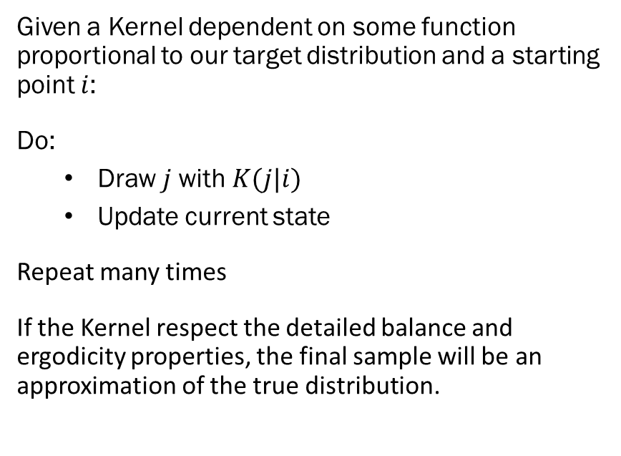
MCMC
Know the process
Don’t know the solution
Given a Kernel dependent on some function proportional to our target distribution and a starting point $i$:
Do:
Draw $j$with $K(j|i)$
Update current state
Repeat many times
If the Kernel respect the detailed balance and ergodicity properties, the final sample will be an approximation of the true distribution.
Sample with a Markov chain
Approximate distribution with the sample
What is the best Kernel?

Slide 13
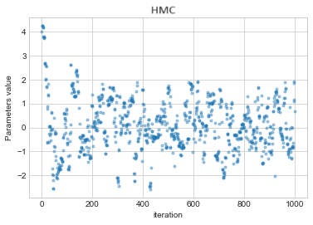
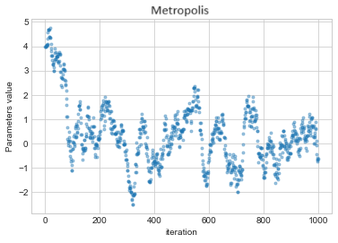
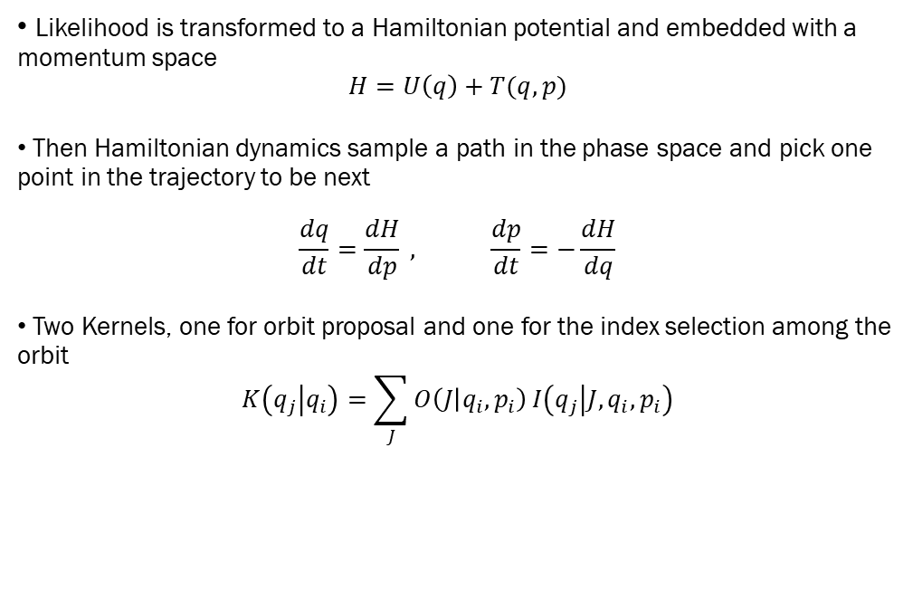

Hamiltonian Monte Carlo
$$i$$
$$j$$
Likelihood is transformed to a Hamiltonian potential and embedded with a momentum space $H=U\left(q\right)+T(q,p)$
Then Hamiltonian dynamics sample a path in the phase space and pick one point in the trajectory to be next $\frac{dq}{dt}=\frac{dH}{dp} , \frac{dp}{dt}=−\frac{dH}{dq}$
Two Kernels, one for orbit proposal and one for the index selection among the orbit $K\left(q_{j} | q_{i}\right)=\sum_{J}{O\left(J | q_{i},p_{i}\right)}I\left(q_{j} | J,q_{i},p_{i}\right)$

Slide 14
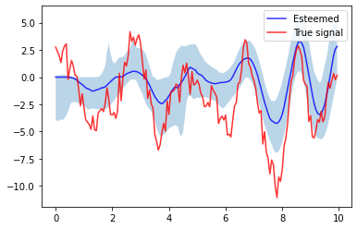
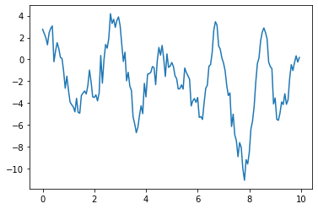
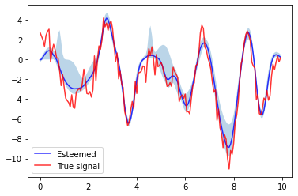
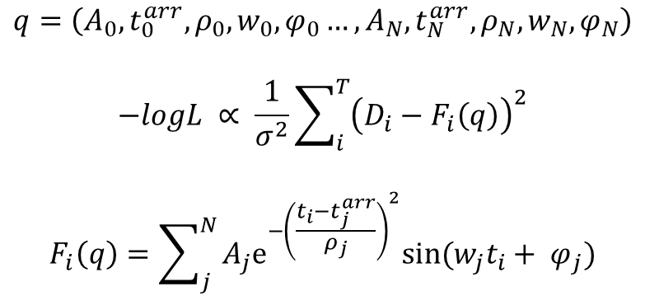
Current application
A signal D is recorded for a time T
There are N waves in the signal
Each wave can be described by 5 parameters
A gaussian error is assumed on the data acquisition
$$q=\left(A_{0}, t_{0}^{arr}, ρ_{0}, w_{0},φ_{0}…,A_{N}, t_{N}^{arr}, ρ_{N}, w_{N},φ_{N}\right)$$
$$−logL ∝ \frac{1}{σ^{2}}\sum_{i}^{T}{{\left(D_{i}−F_{i}\left(q\right)\right)}^{2}}$$
$$F_{i}\left(q\right)=\sum_{j}^{N}{A_{j}e^{−{\left(\frac{t_{i}−t_{j}^{arr}}{ρ_{j}}\right)}^{2}}sin⁡(w_{j}t_{i}+ φ_{j})}$$

Slide 15

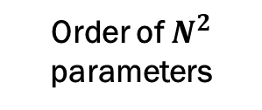


Curse of dimensionality
Typical Set get smaller
$$…$$
$$1/3$$
$$1/9$$
Order of $N^{2}$ parameters
$N(N−1)/2$ parameters, given N neuron $O\left(N^{2}\right)$ weigths
Slow performance
Each Hamiltonian step require multiple evaluation of the likelihood and its derivative

Slide 16
Thank you
References • Probabilistic Decision Making by Slow Reverberation in Cortical Circuits, (Wang 2002)
• Firing Frequency of Leaky Integrate-and-fire Neurons with Synaptic Current Dynamics, (Brunel
Sergi 1998)
• Mean-Field Theory of Irregularly Spiking Neuronal Populations and Working Memory in Recurrent
Cortical Networks, (15 chapter, Renart)
• Effects of Neuromodulation in a Cortical Network Model of Object Working Memory Dominated by
Recurrent Inhibition (Brunel Wang 2001)
• Model of Global Spontaneous Activity and Local Structured Activity During Delay Periods in the
Cerebral Cortex (Amit Brunel)
• Brain mechanisms for perceptual and reward-related decision-making
Marco Recchioni
University of Pisa

